Slide 1
Gulf Coast Power Association MISO South Regional Conference February 21, 2019
Panel Session: Next Generation of Market Machines
Role of Regulatory & Market Participant
18368528-1

Slide 2
Largest full-service law firm in the Capital Region
We serve industries that drive the regional economy
Energy sector is our core expertise

Slide 3
Louisiana Energy Users Group (“LEUG”)
Association of 24 large industrial companies with plants located in the State of Louisiana.
Diverse Membership - - Chemical Manufacturing, Refining, Pulp and Paper, Industrial Gases, Pipeline.
Collectively, provide about 35,000 good, high paying jobs in Louisiana, and spend over $6 Billion in Louisiana each year on electricity, goods and services.
All members buy large amounts of electricity from Entergy Louisiana.
Some members also have cogeneration to meet some portion of their needs, and some of those have excess power they sell into the MISO market or to Entergy.
Website: laenergyusersgroup.org

Slide 4
Focus:
Projected Entergy Generation Deactivations and Replacement/Costs.
Industrial Customers Want To Be Part Of The Solution - -
- help avoid some of the need for Entergy to replace aging generation fleet;
- in a manner that provides savings for all ratepayers; and
- at the same time, help industry in Louisiana maintain competitive electricity
prices.

Slide 5
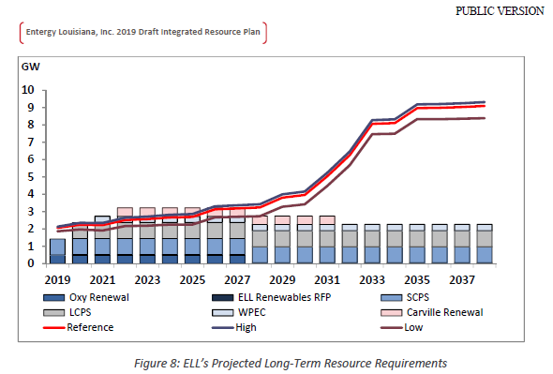
Entergy Draft Integrated Resource Plan Excerpt
Projected long-term capacity deficit to approach 7,000 MW (Draft IRP, page 10)
5,800 MW of deficit is from generation deactivations (Draft IRP, page 6)
3,100 MW of deficit is legacy gas units over the age of 40 years (Draft IRP, page 6)
Only 750 MW of deficit is from load growth (Draft IRP, page 69)

Slide 6
Entergy Legacy Generation Units
Remaining Entergy Legacy Gas-Fired Generation – 3,116 MW
Little Gypsy 2: 401 MW (1966 in-service / 53 years old)
Little Gypsy 3: 508 MW (1969 in-service / 50 years old)
Ninemile 4: 669 MW (1971 in-service / 48 years old)
Ninemile 5: 740 MW (1973 in-service / 46 years old)
Waterford 1: 399 MW (1975 in-service / 44 years old)
Waterford 2: 399 MW (1975 in-service / 44 years old)
Recent Accelerations of Legacy Generation Unit Deactivation Plans
Willow Glen Units 2/4 (662 MW) accelerated from 2027 to 2016.
Nelson Unit 4 (424 MW) accelerated from 2030 to 2017.

Slide 7
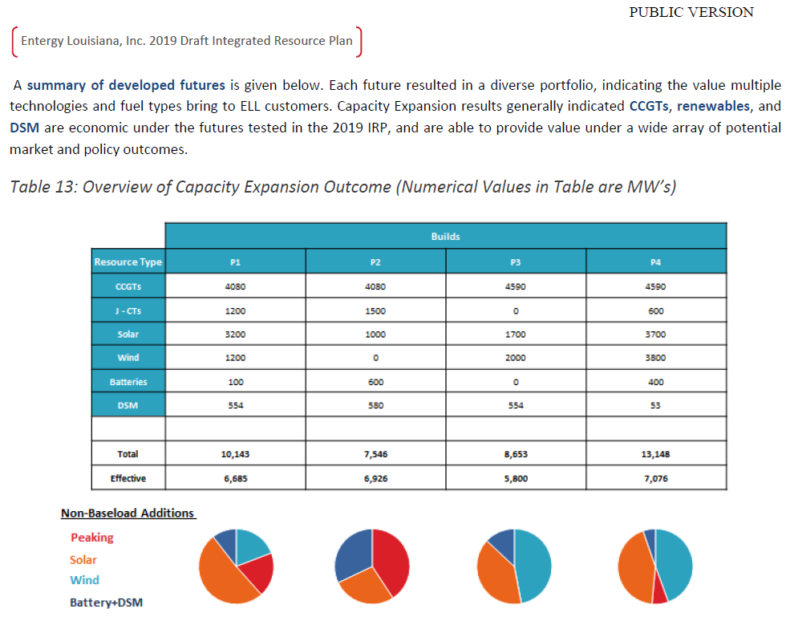
Entergy Draft Integrated Resource Plan Excerpt
Portfolio analysis of potential replacement generation

Slide 8
Entergy Outlook For Potential Generation Replacement Resources
Entergy indicates Portfolios 1 and 3 balance “planning objectives of Cost and Risk while considering Reliability.”
Portfolios 1 and 3 indicate a range of potential resource types as follows:
4,080 - 4,590 MW: Combined Cycle Combustion Turbine (CCGT)
0 - 1,200 MW: Combustion Turbine (CT)
1,700 - 3,200 MW: Solar Generation
1,200 - 2,000 MW: Wind Generation
0-100 MW: Battery Storage
554 MW: Demand Response (does not include Industrial Customer Demand Response products)

Slide 11
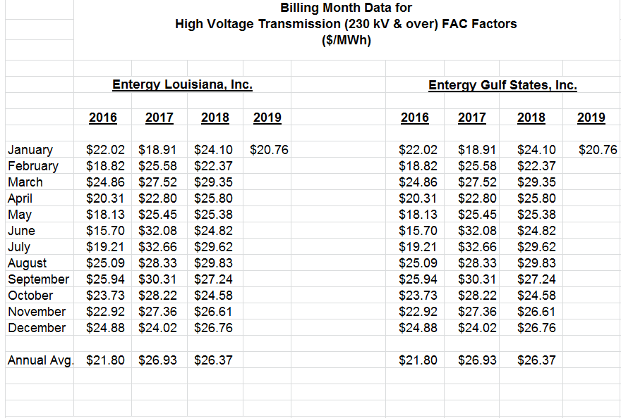
Entergy Fuel Costs
Fuel Adjustment Has Been Relatively Low In Recent Years
Entergy Projects Variable Costs To Go Up, Not Down
(Draft IRP, page 104)

Slide 12
LEUG Concern: competiveness of future Industrial electric rates in Louisiana given large amounts of upcoming replacements of Entergy generation fleet.
Unique Opportunity: are there proposals that Industrials can pursue that would reduce some of the need for replacement generation and save costs for all ratepayers, while also providing competitive options for Industrials?

Slide 13
LEUG Proposals:
Industrial Customer Market Option – including enhanced Combined Heat and Power (“CHP”) opportunities.
Industrial Customer Tariff Options – (a) Interruptible service option, (b) Real-time pricing option, (c) Market-based stand-by service rate option.
Procedure – LPSC proceedings to investigate/consider LEUG proposals: (a) 90 Day Proceeding on Tariff options, (b) 9 Month proceeding on Market Option.
Status: LPSC Technical Conferences held in May and October 2017; LPSC Staff report, subject to comment process; and then anticipate LPSC will decide whether to initiate proceedings proposed by LEUG.

Slide 14
Take Aways:
Industrial customers want to be part of the solution - -
- help avoid some of the need for Entergy to replace aging generation fleet;
- in a manner that provide savings for all ratepayers; and
- at the same time, helps industry in Louisiana maintain competitive electricity prices.
2) If an industrial customer is willing to take on the risk of meeting its electricity supply on its own, the cost of replacement generation could be avoided for the benefit of all ratepayers.
3) Likewise, if industrial customers are allowed to participate in new demand response tariffs and products, the need to replace some of Entergy’s aging generation fleet could be avoided.
4) LEUG urges that the time to investigate these options is now - - and not wait until there is a proposal on the table to construct another new generation unit that will have to be paid for through rate increases for all ratepayers.

Slide 15
Randy Young
Partner
Kean Miller LLP
II City Plaza
400 Convention Street, Suite 700
Baton Rouge, Louisiana 70802
Post Office Box 3513 (70821-3513)
225.382.3451
randy.young@keanmiller.com

